Slide 1


Increase Change with Open Source API Management
Johan Edling
Notes:
Learning areas
API based approach for gradual transformation of application landscape
How to address technical debt in form of large monolith
Highlighting unplanned benefits that will arise by API standardization
Potential Benefits
Enable rapid parallel development of digital experiences
Enable gradual replacement of old monolithic system
Enable reuse of functionality in new channels and areas by both internal and external partners
Lindex faced a problem when trying to initiate multiple new digital channel development. Problem was the limitation set by the existing monolith powering existing digital channels and the one team that supported it. By choosing an API based approach for exposing functions and employing WSO2 API Manager for proper management of clients, access control and usage limits parallel development was enabled. When complemented with WSO2 Identity Server Lindex positioned its digital landscape to further transformation. Using domain driven design and bounded context thinking has enabled us to easier change parts of the monolith at different speeds.

Slide 2
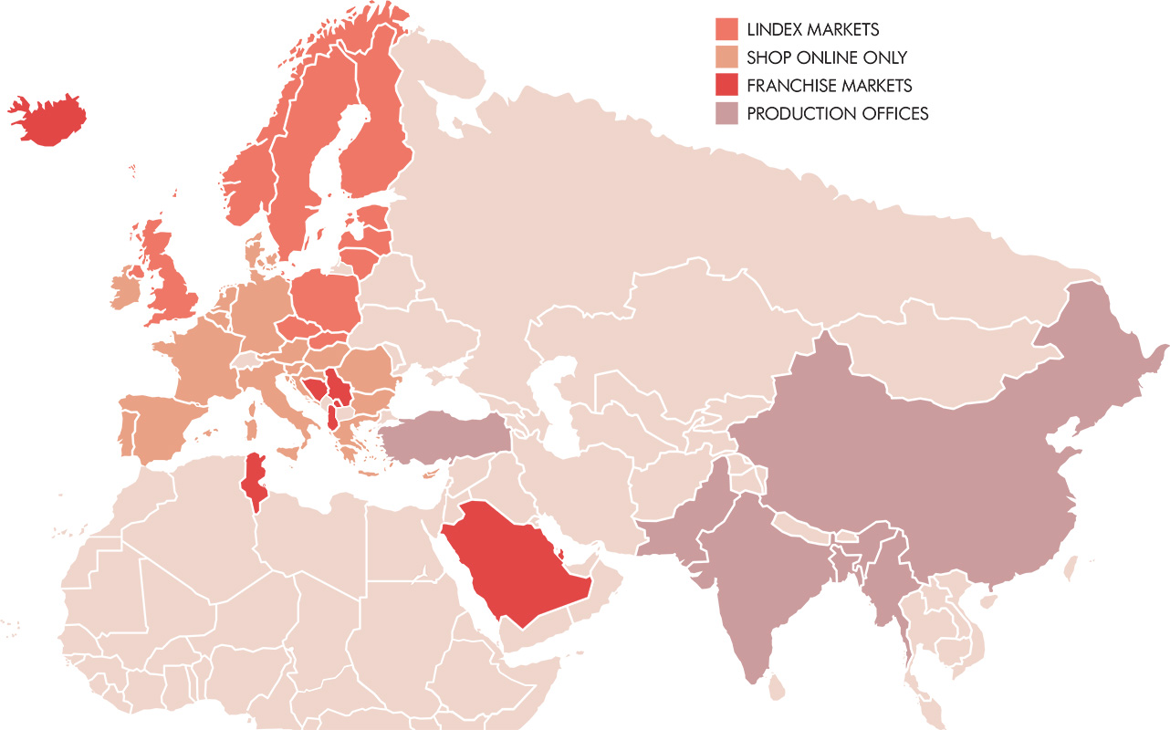
To empower and inspire women everywhere
Lindex is one of the leading fashion chains in Europe with 470 stores in 18 markets.
Euro 606 million in turnover 2017
Approx. 5 000 employees.
Head office in central Gothenburg, Sweden. Founded 1954 in Alingsås, Sweden
Part of the Finnish listed company Stockmann since 2007
55% of our garments are made of sustainable materials
Notes:
Retail
Big transformation as everyone knows and is talking writing about
Very exciting lots going on
Need for increased transformation capabilities (competition, behaviour, expectations)
Internal changes as well

Slide 3

Highlights being covered
Business
Going from one development team to multiple customer experience focused teams
Composing applications for a specific user group
Enable experiments for functionality
Technical
Hide your monolith behind a layer of APIs
APIs really unlocks possibilities
API is a technique, remember to do proper design.

Slide 4

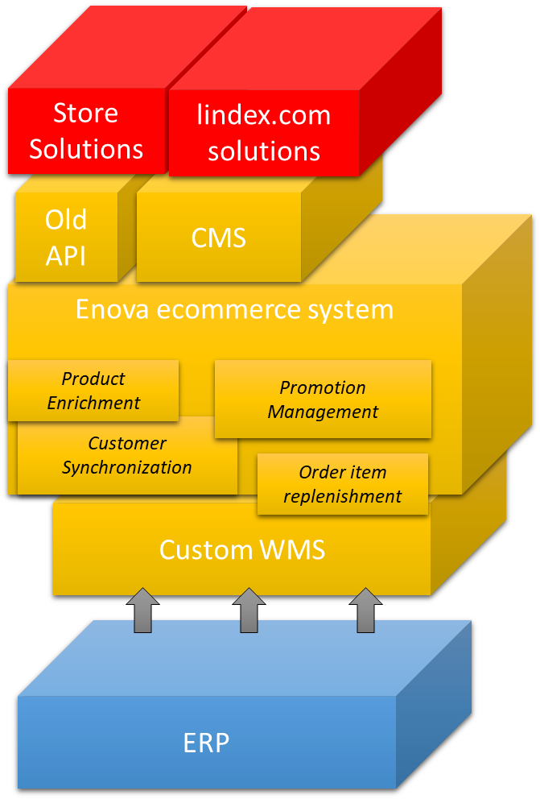
Online presence after 10 years iterations
Notes:
Online presence and ecommerce since 2007
Served us well – started as an experiment back in the day – hobby – carry it’s own cost – entrepreneurship
Monolith - Maintained by a smaller team
Lots of data synchronization in the background
Big picture not known by anyone
Technical debt not known or payed down
Not architecturally suitable any longer

Slide 5

Change agent – Customer Loyalty App
Notes:
Other change agents on horizon:
New site with new CMS backend
New “Commerce backend"
Promotion management
New CRM solution
Maintenance team not scalable

Slide 6
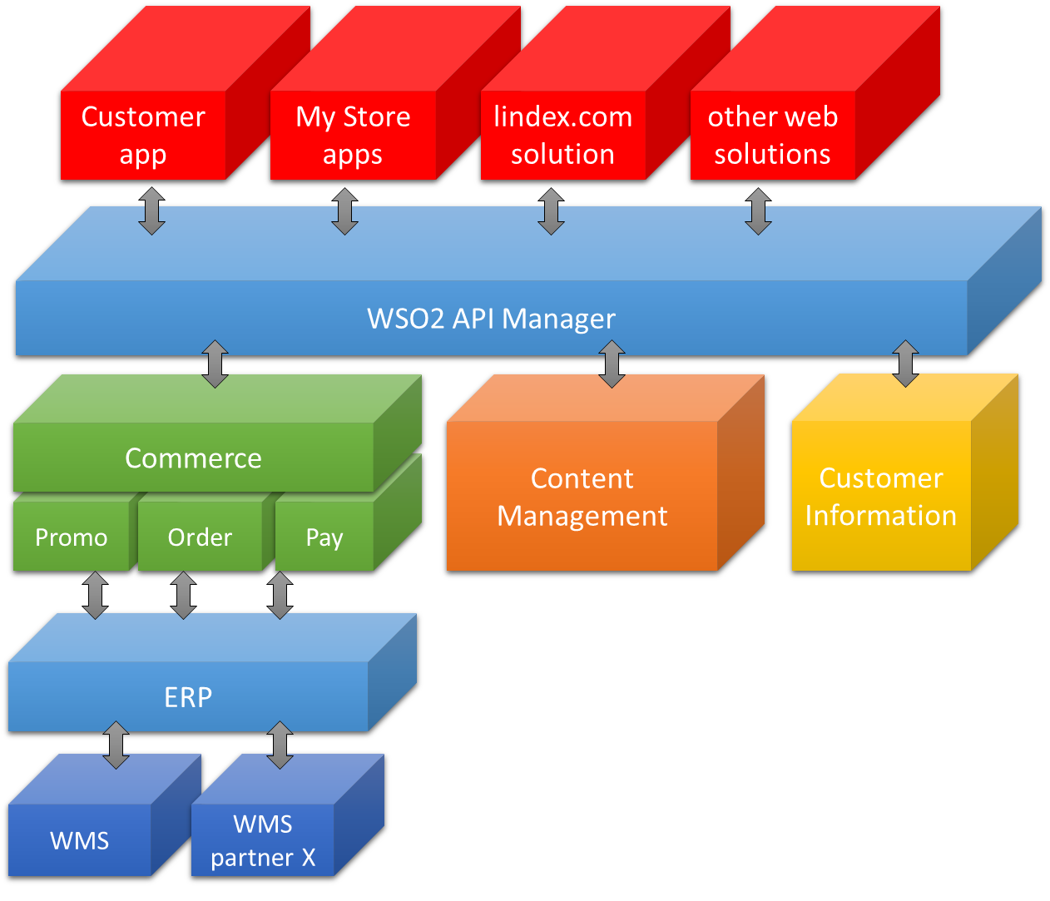

The simple concept
Notes:
Hide everything behind an API-layer - change back-end incrementally – API First
Try to model generically but don’t complicate
Several teams supporting one or multiple parts of the solution
First iteration it was the old monolith providing the services
Second iteration we start to introduce new services behind, versioning
Clients can start to use new versions of apis (and backend of at their own time plan)
Some introductions requires synchronized switches (kill switches for public apps) omni-channel capabilities

Slide 7

Enter WSO2 API Manager
Active
Gateway
Key Manager
Store + Publisher
Hot standby
Gateway
Key Manager
Notes:
Needed something for that api layer.
API Management
Broadly adopted method of documenting API (Swagger/OpenAPI Specification)
Provide identification to backend services (“remove identification from developers”)
Connect to existing customer authentication solution
Local knowledge in Gothenburg
Obviously happy with the choice

Slide 8

Benefits with WSO2 and open source
No upfront costs
Plenty of extension points
Start simple - add capabilities from WSO2 ecosystem
Helpful community

Slide 9
Extended with WSO2 Identity Server
Active
API Manager Gateway
Identity Server
API Manager Store + Publisher
Active
API Manager Gateway
Identity Server

Slide 10
Mutliple user repositories with WSO2 Identity Server
Active
API Manager Gateway
Identity Server
API Manager Store + Publisher
Active
API Manager Gateway
Identity Server
Customers
Employees

Slide 11

What we have learned (so far)
Upgrading is troublesome
Sequence development not intuitive, difficult to debug and generally not developer friendly
Lots of configuration files spread-out over multiple directories
Support is responsive

Slide 12
App overview
WSO2 API Manager Gateway Worker
WSO2 Identity Server
Lindex Customer User Store
Lindex Customer
Lindex Active DIrectory
Commerce
Clustered Sterling Integrator
Customer
Bonus Master
Barcode
Customer Identification
lindex.com
Customer
Master
Customer
Message
AppInfo
Fredhopper
Merchendising
Adobe Campaign
ERP
Notes:
Initial effort to have the existing functionality available as REST resources
In our case the effort varied quite dramatically between a few backend teams. With solid development practicies, unit testing and automation it was fairly easy
With a lot of technical debt to deal with an no tests it was a mess
Key for us in enabling the app in a standard way was the ability to integrate the customer user store. WSO2 user store interface was really key for enabling a smooth customer onboarding
One can come someway with the possibility to expose and convert payload of existing services but realistically you need an ESB layer or (preferably) reimplement a new interface

Slide 13
Extended overview
WSO2 API Manager Gateway Worker
WSO2 Identity Server
Lindex Customer User Store
Lindex Customer
Lindex Active DIrectory
Commerce
Clustered Sterling Integrator
Customer
Bonus Master
Barcode
Customer Identification
lindex.com
Customer
Master
Customer
Message
AppInfo
Fredhopper
Merchendising
Adobe Campaign
ERP
Notes:
The other initiatives
My Store ofr in store efficiency
New web site (head less commerce)
Added some additional resources within each domain but and some additional domains (not shown here for brevity)

Slide 14


Innovation happens
Franchise partners ecommerce
Standalone campaign pages
POS - Customer lookup
Czech EET fiscal reporting
Customer info terminals in store
My Stock, My Day, My Customer
GDPR modifications to loyalty
External Customer Community
Franchise Partners
WSO2 API Manager Gateway Worker
Commerce
Clustered Sterling Integrator
Customer
Bonus Master
Barcode
Customer Identification
WSO2 Identity Server
Lindex Customer User Store
Lindex Customer
lindex.com
Customer
Master
Customer
Message
AppInfo
Fredhopper
Merchendising
Adobe Campaign
ERP
Lindex Active DIrectory
Notes:
While we had our big transformation program running we have been able to get things done quickly, invent, experiment with a few other things thanks to the availablity of the web api resources in parallel
We could offer our franchise partners easy access to the enriched product information that they required and they could choose which they needed
The standalone campaign pages we made was more interactive because of the product apis
Once we finally got around to do customer lookup from the POS everything was available
Every fiscalization is a mess but soemwhat easier thanks to the order resources (for ecommerce transactions paid in store)
We experiment could evaluate customer info terminals in store at POS desk quickly as all resources was available (because of the app). Later discarded solution, not enough of our customer found them useful
We could expand the My Store program with some more specific task thanks to resources that were provided as part of package for app and web
GDPR psuedo-anonymization was slightly easier by some customer oriented resources
Recently we hooked up a customer community external service to our authentication solution. Less accounts and more consistent experience for the customer. Less data floating around as well since the external service can fetch needed information from our api

Slide 15




Customer experience teams
Franchise Partners
WSO2 API Manager Gateway Worker
WSO2 Identity Server
Lindex Customer User Store
Lindex Customer
Lindex Active DIrectory
Commerce
Clustered Sterling Integrator
Customer
Bonus Master
Barcode
Customer Identification
lindex.com
Customer
Master
Customer
Message
AppInfo
Fredhopper
Merchendising
Adobe Campaign
ERP
Notes:
Mentioned we started out with only one team for cx development
Several, obviously the ones developing the channel application
But also the ones responsible for the backend services
We are now evaluating how to make the team responsibilites as frictionless as possible.
As I am sure many experienced many experience the number of teams involved for delivering something the more complex it becomes from a synchronization. Someone is waiting for someone else. That might be a different topic altogheter.
The standardization on OpenId Connect, Oauth and our particular adoption of REST has enabled channel developers to be productive and fairly independent.
The REST api standardization has also meant the backend teams can focus more on functionality, process and less on ”infrastructure” coding

Slide 16

The (mid-term) results are in
Multiple teams developing customer experience solutions
Customer and commerce engagement in unplanned places
Experiments are carried out since the development effort is lower
Strategy for gradually replacing backend functionality working working
WSO2 and open-source makes starting out a breeze

Slide 17

If starting over we would
Set up statistics of API usage immediately - might seem expensive but you will regret not having it
Allocate time for development and changes to API resources
If necessary use force to setup automatic testing of API resources
Make sure API development skills are part of affected teams
Document guidelines for error handling from both service implementation and client perspective

Slide 18

Next
open source
catalysts
Notes:
Next for Lindex

Slide 19



Next open source catalysts
ActiveMQ Artemis
Cross platform messaging
Standardize asynchronous application to application messaging
Kubernetes
Next step for infrastructure as code
Easier continuous deployment
Increase quality
Horizontal scaling in our data center
Path to the cloud

Slide 20

Highlights
API really unlocks possibilities
Functionality is easier to reuse
Provides starting point for teams to be independent
Remember to do proper design for the APIs
Apply Bounded Context and DDD
Hide your monolith behind a layer of APIs
Centralizing customer identification is key
Lets developers focus on functionality not infrastructure
Find something that can hook into what you have
Open source lowers entry level

Slide 21

Thank You

